Slide 1



Slide 2
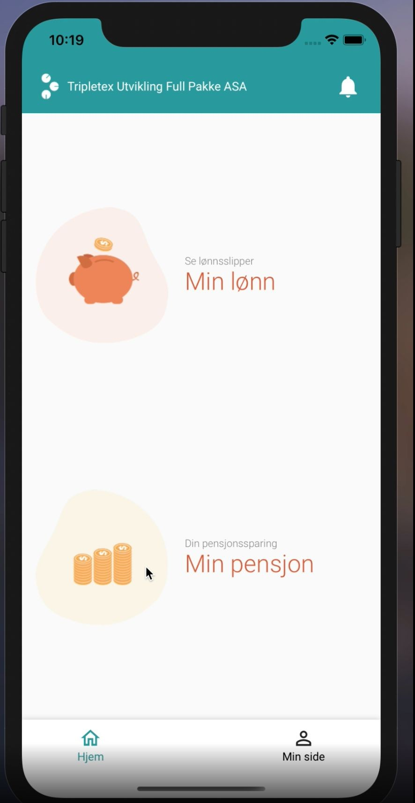
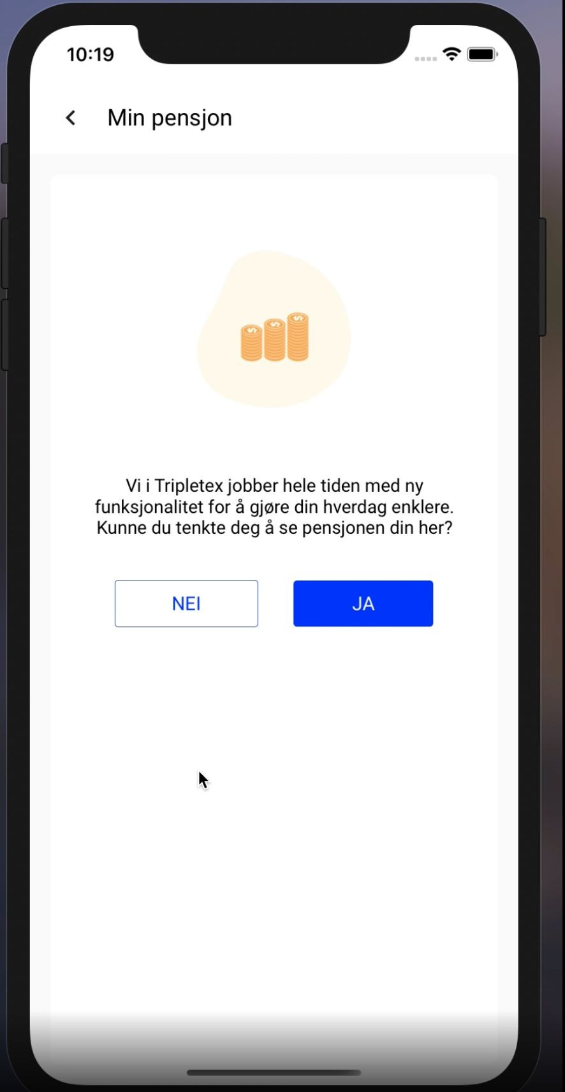
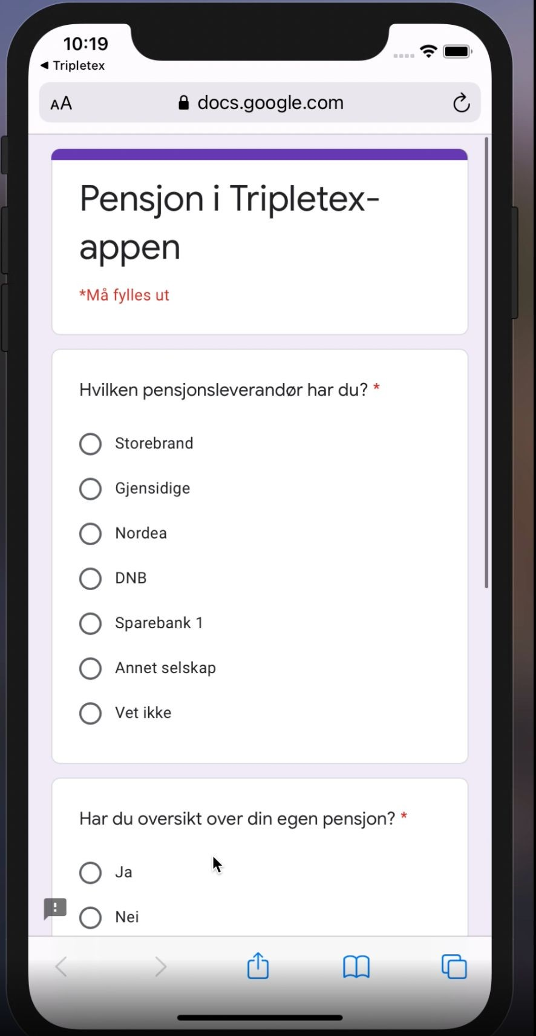
From the 17th of December until the 14th of January we conducted a fake door test:
Our end users that only have the salary module in the app were exposed for a new icon - “Min pensjon”
This page has been exposed 8439 times 1367 users have pushed NEI
3531 users have pushed JA
3541 users have either pushed NEI or JA
1097 users out of the 3531 that pushed JA have completed the questionnaire

Slide 3
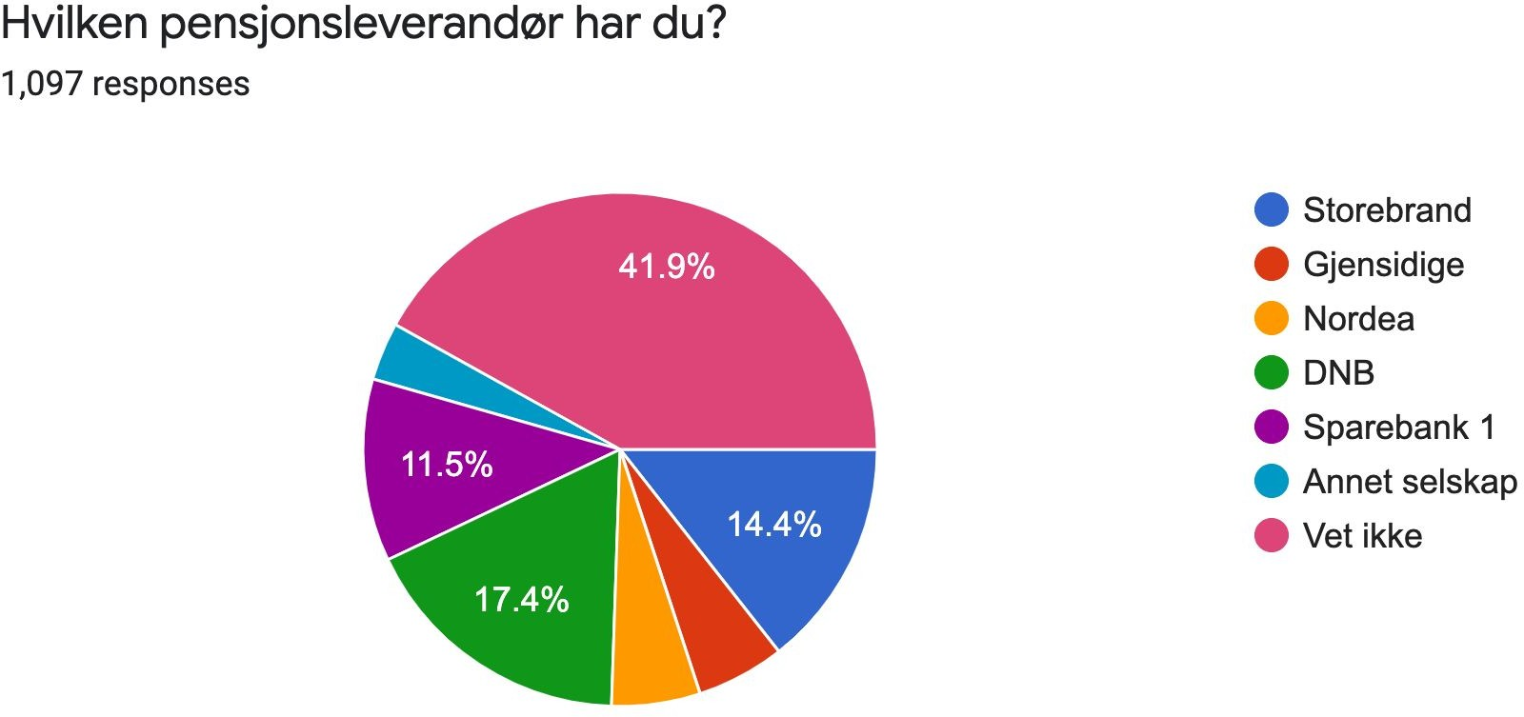
As much as 41.9 % of the users do not know which pension vendor that they have, showing that there is a huge information/attention gap amongst many customers regarding their pension
*

Slide 4
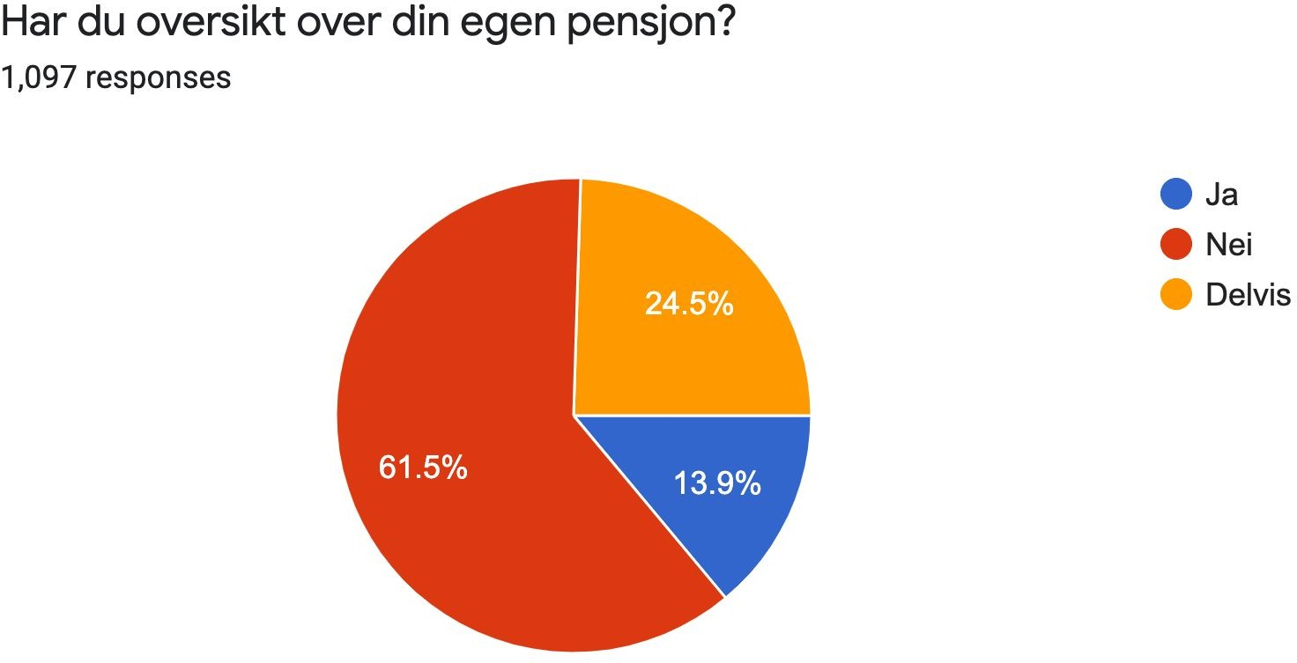
Only 13.9 % feel that they have overview over their own pension, while as much as 61.5 % say that they don’t have overview, and 24.5 % only have partial overview, confirming the information gap for customers

Slide 5
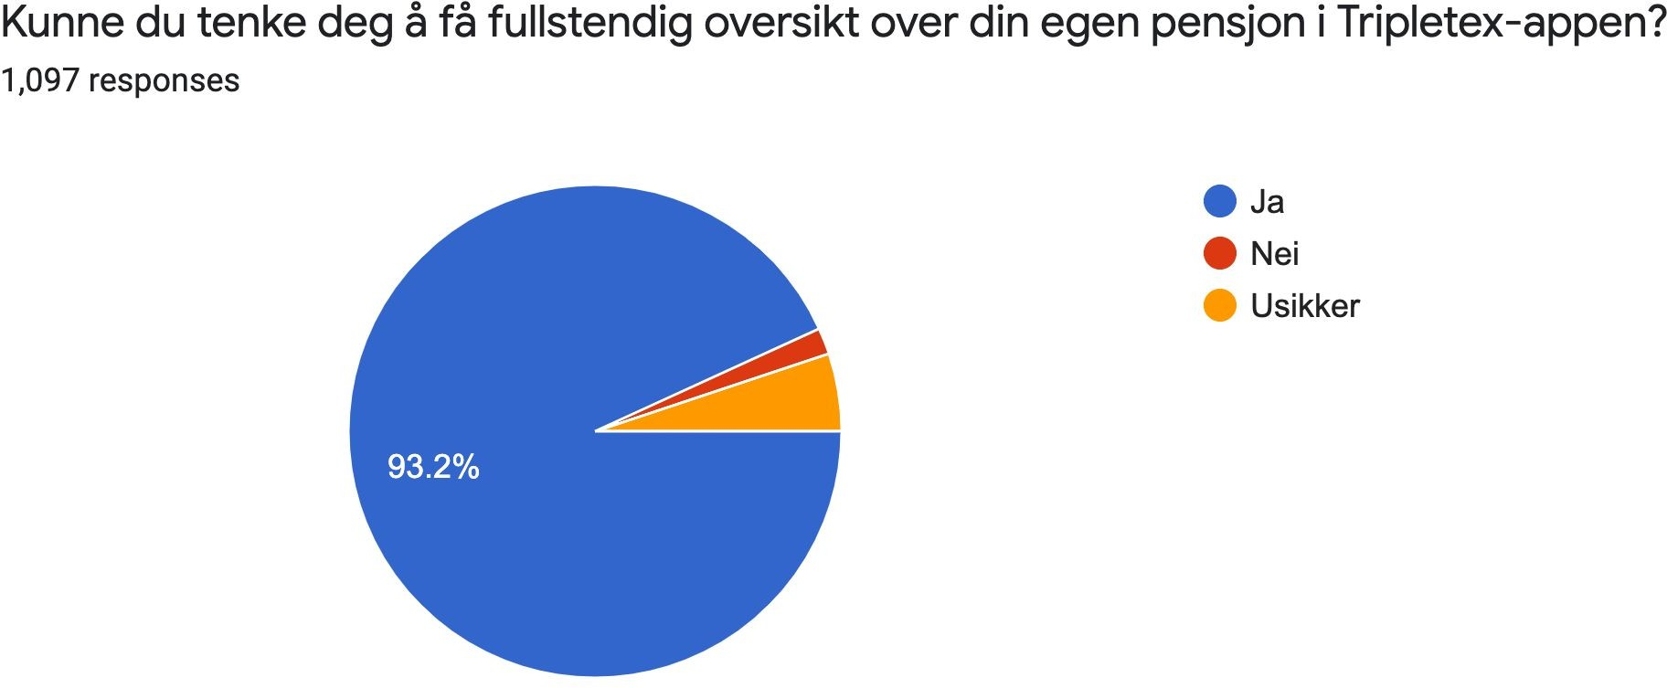
A whopping 93.2 % would like to have full overview over their pension schemes inside the Tripletex app

Slide 6

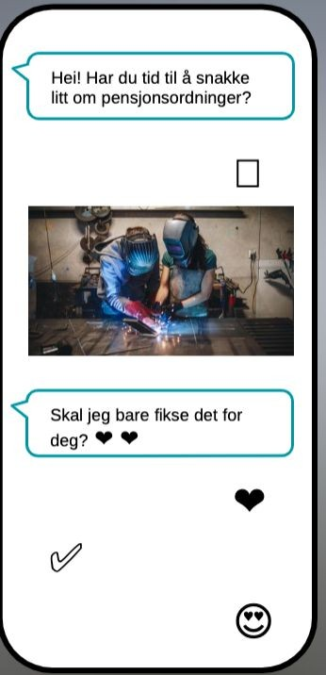
B2B

Slide 7

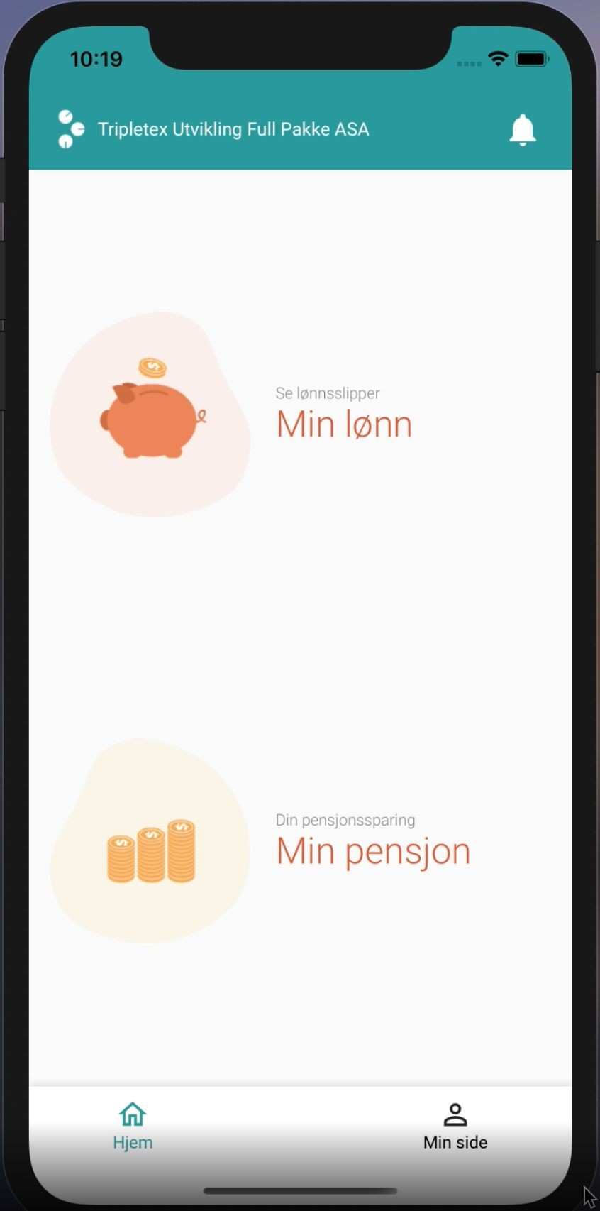
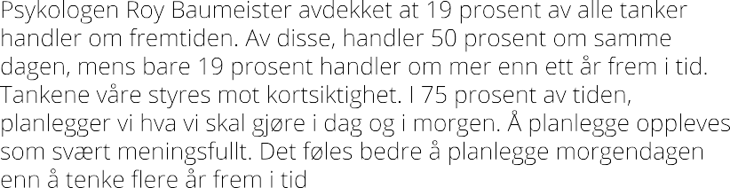
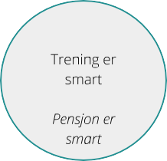
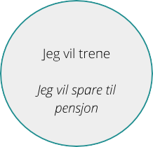
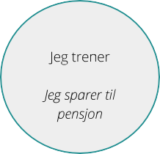
B2B2C
Holdning
Intensjon
Atferd
“Alle” er her
Mange er her
Relativ få kommer hit

Slide 8

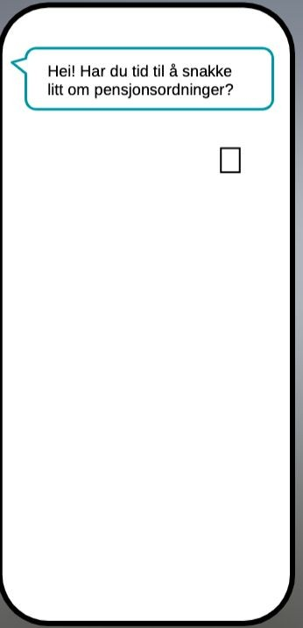
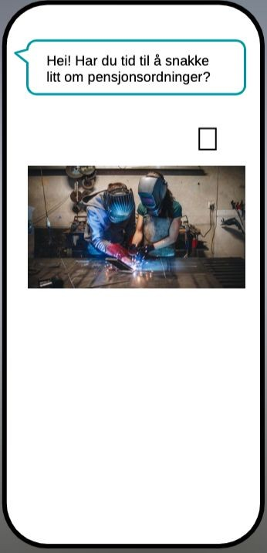
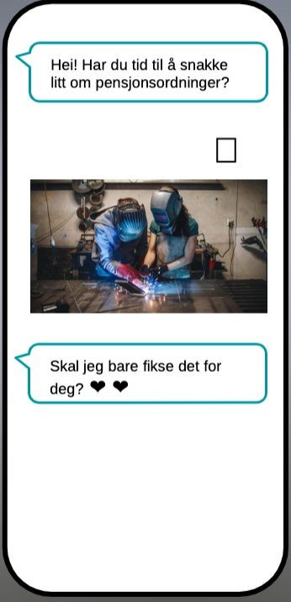
B2B + B2B2C
Verdiforslag =
Vi gjør det superenkelt (automagisk) å kjøpe og administrere pensjon (fra STB) for bedrifter i Tripletex, samtidig som vi gir de ansatte full oversikt over sin egen pensjon i Tripletex-appen. En vinn/vinn-situasjon for bedriften og deres ansatte
*Please note that is just initial thoughts - customers tests and iterations ought to be done and is a natural part of this case

